Slide 1
Lessons Learned from an Evaluation of a Shared Representation to Support Collaboration
John A. Allen, Honeywell
Michael Dorneich, Honeywell
David Mott, IBM UK
Ali Bahrami, Boeing USA
Jitu Patel, Dstl UK
Cheryl Giammanco, ARL USA
KSCO
February 2012

Slide 2
The Problem
Military Planning is hard. Coalition Planning is even harder.
Properties of Military Planning
  Distributed
  Hierarchical
  Cross Disciplinary
Properties of Coalition Planning
  Everything on the left panel
  No tool integration
  Cultural differences
The Goal: Develop a Collaborative Planning Framework that supports Coalition Planning.
Notes:
) to represent collaborative, human generated battle and functional plans at two levels of command of a joint US-UK operation. Specifically, we proposed to study the ability of coalition team members to use the CPM to accurately understand concepts and relationships illustrated through the representations, and to achieve a common plan. The goal was not to rate the quality of the plan or the tools used to create it, rather the focus was on the CPM representation’s ability to capture the planning process in enough richness to enable a shared understanding between planners.

Slide 3
The Collaborative Planning Model
Designed to:
  Represent military plans
  Support the planning process
  Provide a common human and machine understandable representation
For more detail, see the talk:
  “An Interoperable Framework for Distributed Coalition Planning: the Collaborative Planning Model”.
basic logic and rationale | Agent, Assumption, ConceptualSpace, Container, Entailment, Inconsistency, PossibleWorld, Proposition, PropositionIndex, Quantity, ReasoningStep, Set, Triple, VarBinding, WorldState
general | ConceptualThing, Constraint, Synchronisation, Context
temporal | Precede, TemporalConstraint, TemporalEntity, TimeInterval, TimeLine, TimePoint
space | Area, Elevation, Line, Point, SpatialConstraint, SpatialCoordinateSystem, SpatialEntity, SpatialIntersection, SpatialLocation, SpatialUnion
resources | Resource, ResourceAllocated, ResourceCapability, ResourceConstraint, ResourceQuantity, ResourceSet
actions | Activity, Effect, Precondition
collaborative problem solving | Choice Point, Collaboration, Commitment, Communication, ConstraintViolated, Decision, GoalSpecification, Influence, Issue, JointPersistentGoal, MutualGoal, Problem, Solution, Trust,
planning | Allocation, Evaluation, EvaluationCriterion, InitialState, Plan, PlanTask, PlanTaskDescription, PlanTaskTemplate, PlanningProblem, PlanningProblemContext, ResourceCommitment, ResourceReq, TaskCommitment
military planning | Terrain, Brigade, Division, Field Artillery, Rotary Wing, Mission, Intent, SEIZE, FIND, Intent Area, Decision Point, ResourcePool
Notes:
We believe that the CPM does represent much of the problem solving process, including planning, but …
Must extend this to support the evaluations
Must extend the logical axioms of the entities and relations (via CE and the “logic proposal”)
Must try hard to link to other ITA representations of problem solving processes

Slide 4
Distributed, Cross-UK-US, Hierarchical Planning Evaluation
Evaluate the usability and effectiveness of formal planning representations by assessing
  represent collaborative human-generated battle and functional plans at two levels of command of a joint US-UK operation.
  ability of coalition team members to accurately understand concepts and relationships illustrated through the representations, and
  ability to achieve a common plan
Demonstrate integration possibilities via CPM across multiple planning levels, work cultures, and organisations.
Evaluate whether rationale can be captured and expressed, and whether it is helpful in collaborative planning.
Understand planning as an example of realistic collaborative problem solving
Notes:
we are NOT researching into planning. Planning is merely an example of a problem solving process.
relevent to other’s work.

Slide 5
Planners and Experimenters were to pay particular attention to:
  Things where the researchers have failed to communicate but are present in the plans. - failure to understand the CPM or CE
  Things which are not present in the plans but could be added - failure to elucidate
  Things which are not present in the plans but could not be added without changing the CPM - deficiency in the CPM
  Details which are in the plans but are just wrong - failure to elucidate
  Concepts in the CE/CPM that are wrong - deficiency in the CPM
  Concepts in the CE/CPM that are different between US and UK - cultural differences

Slide 6
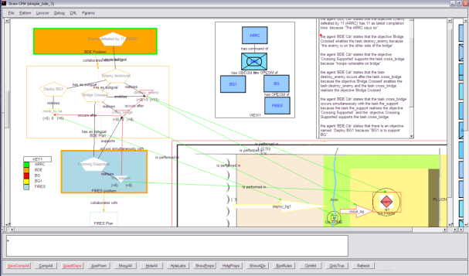
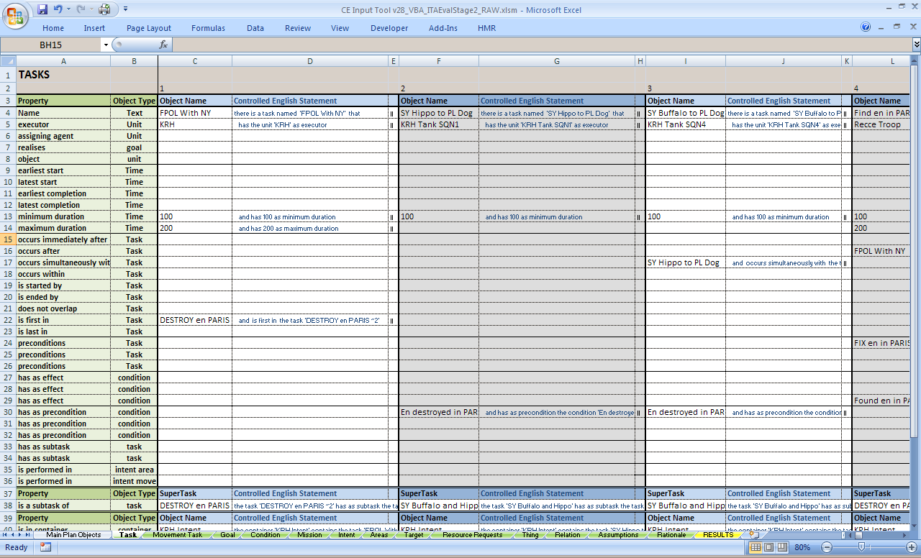
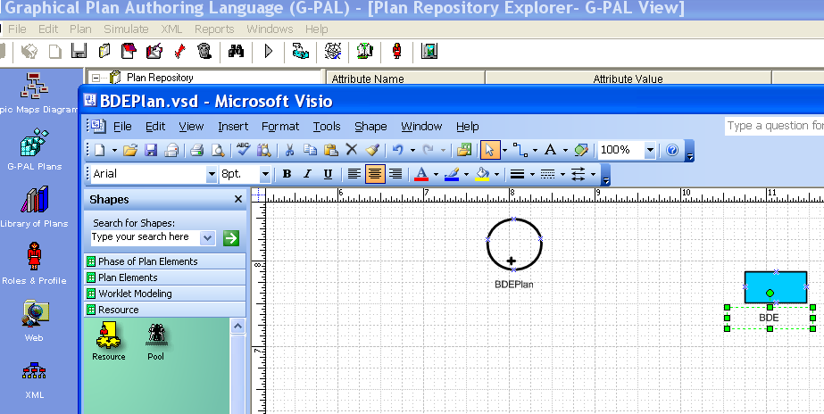
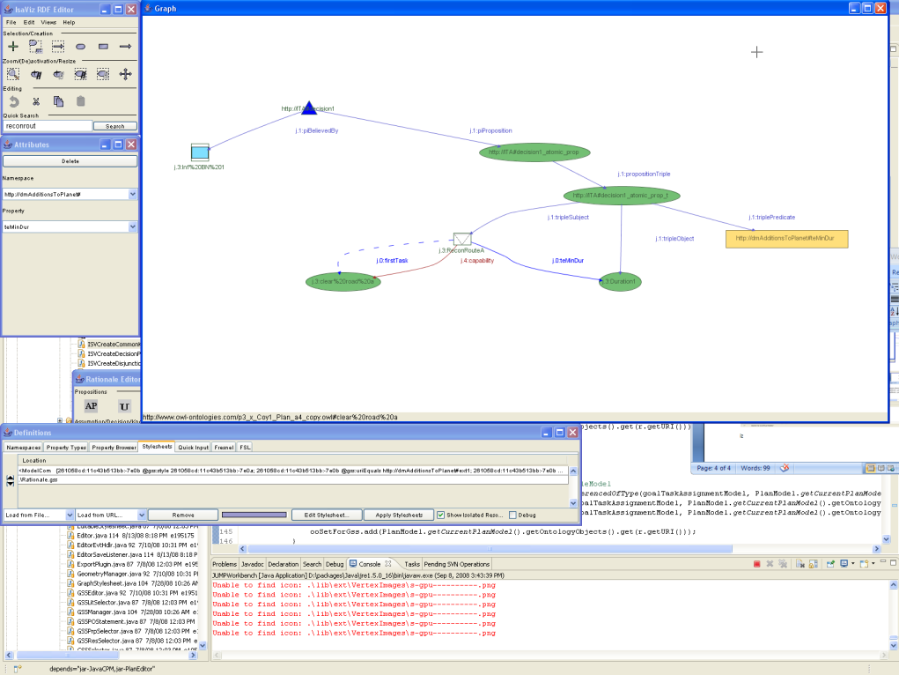
Multiple Tools

Slide 7
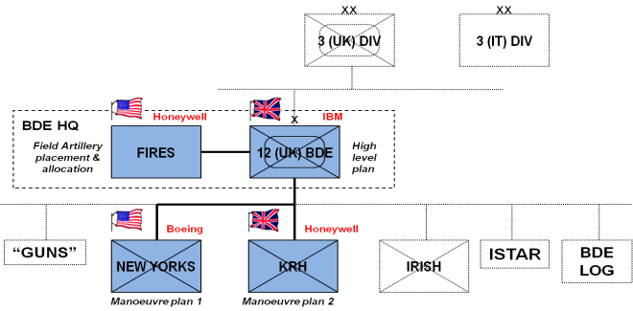
Organisation & Participants
Notes:
The evaluation plan calls for a two stage evaluation, each separated into two elements. Stage 1a will involve one brigade level planner to construct the “main plan” (participant #1). A FIRES component to the high-level plan must then be created (participant #2). Stage 2 will involve the simultaneous development of two battalion plans disseminated (participants #3 and #4). Stage 1a took place over a period of three weeks in January 2011. Stage 1b took place in one day in March 2011. Stage 2 was held about three weeks later.

Slide 8
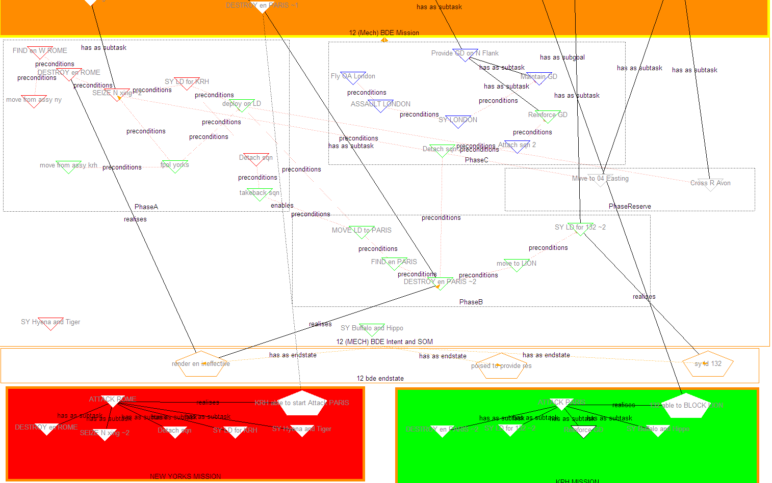
NY and KRH Missions

Slide 9
Lessons Learned
Deployability of CPM
  Demonstrated several types of tool integration using CPM
Planning across multiple levels in a military hierarchy
  Maneuver plans between the Brigade and Battalions
Planning across multiple disciplines
  Maneuver and FIRE plans

Slide 10
Lessons Learned
Utility of Controlled English
  Easier to understand that visual representation (in some instances).
  Light-weight tool
  Capture “on-the fly” information
  Good representation of rationale information.
Differences in word use between UK and US planners.

Slide 11
Lessons Learned
Differences in the planning process between UK and US Planners.
  Level of detail
  Information Passed.
Importance of Rationale
  Pre-conditions/effect
  Plan understanding.

Slide 12
Future Directions
Enhancing the language to cover what’s needed
The construction of Rationale
Configuration Management of plans
Different military vocabularies
Tool Interfaces

Slide 13
End

